Slide 1

Automation Testing
By- Manas

Slide 2
Handling Web Table in Selenium WebDriver
A Web Table in Selenium is a WebElement used for the tabular representation of data or information. The data or information displayed can be either static or dynamic. Web table and its elements can be accessed using WebElement functions and locators in Selenium. A typical example of a web table would be product specifications displayed on an eCommerce platform.
A Web table is an HTML table displayed on a webpage, used to present structured data in rows and columns.

Slide 3
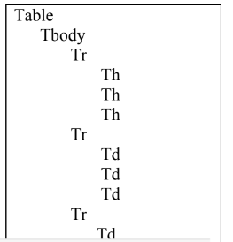
WORKING WITH WEB TABLES
We are using this option to work on webtables in application using webdriver. Sometimes we are getting search results in the table format in applications so those tables we can handle with the help of xapth in webdriver.
HTML Page View

Slide 4
Structure of Web table in HTML Page
Tr : Table Row
Tbody: Table body
Th: Table header/ Table Colum
Td: Table data

Slide 5
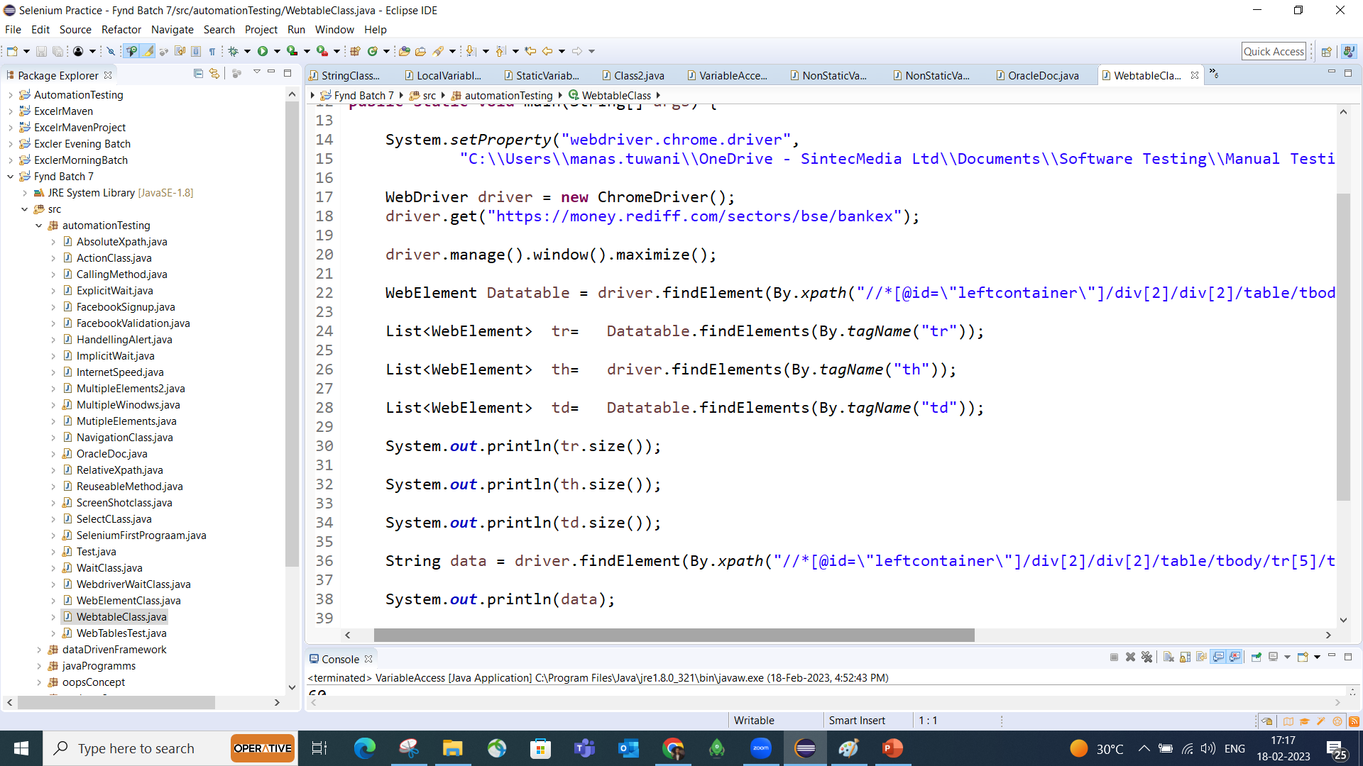
Prepare test script to launch https://money.rediff.com/sectors/bse/bankex application, count
number of rows, coumns in a table in application

Slide 6
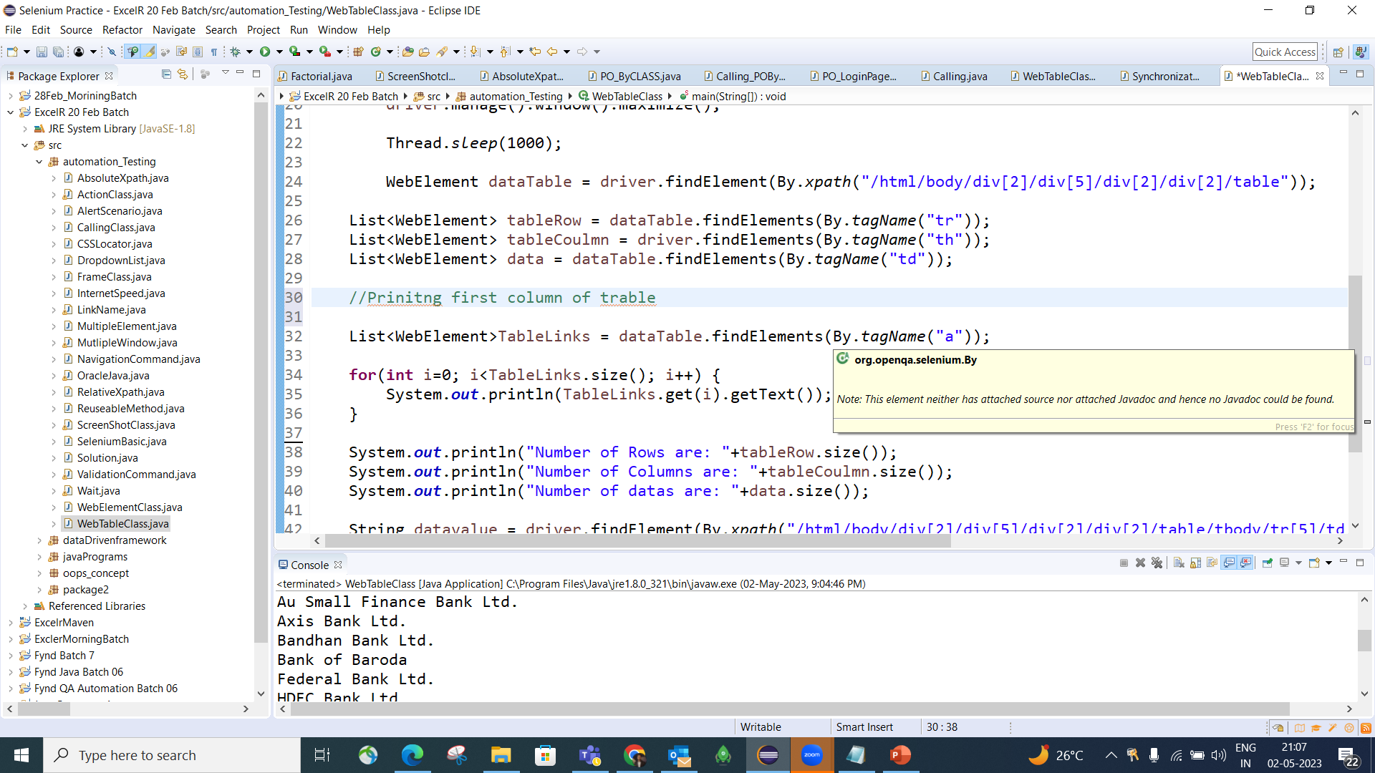

Slide 7
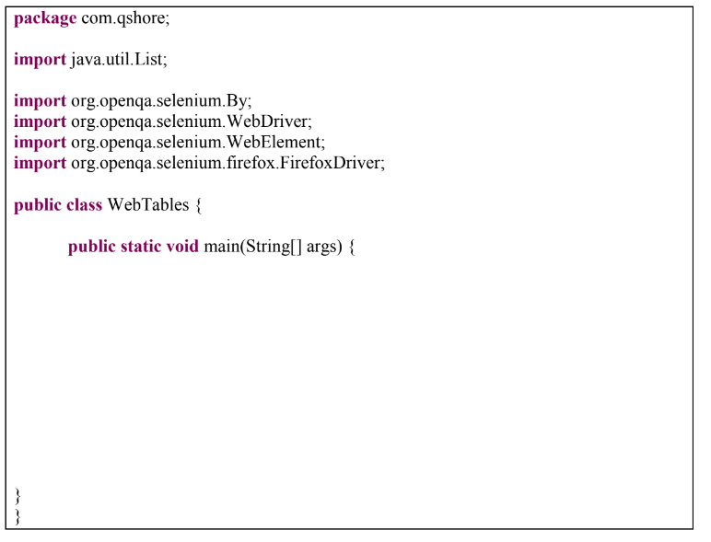
Practice Problem : Prepare test script to launch https://money.rediff.com/sectors/bse/bankex application, count
number of rows in a table and read data from all rows in first column in application.

Slide 8
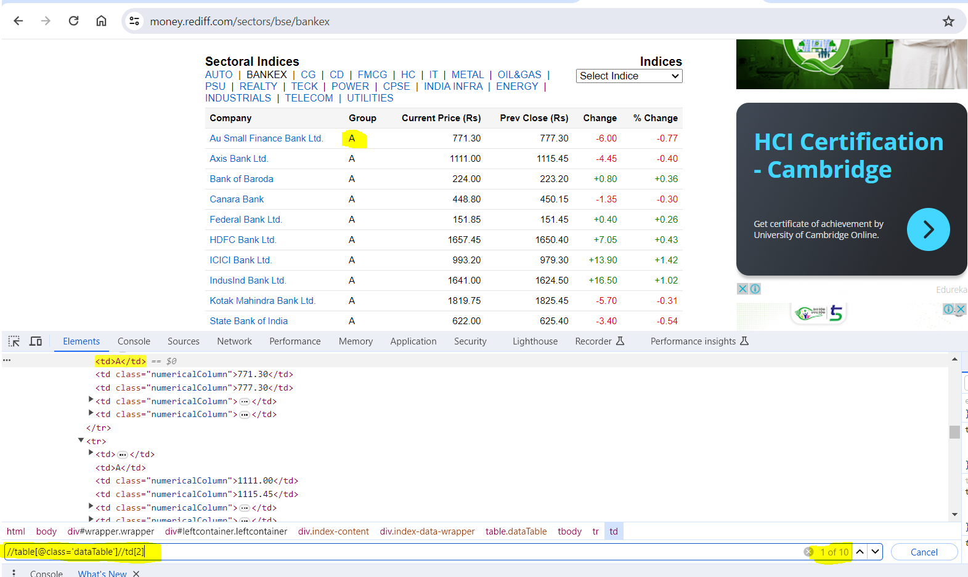
How to Print Entire Column of Table
For Column 2
Xpath: //table[@class='dataTable']//td[2]
For Column 3
Xpath: //table[@class='dataTable']//td[3]

Slide 9
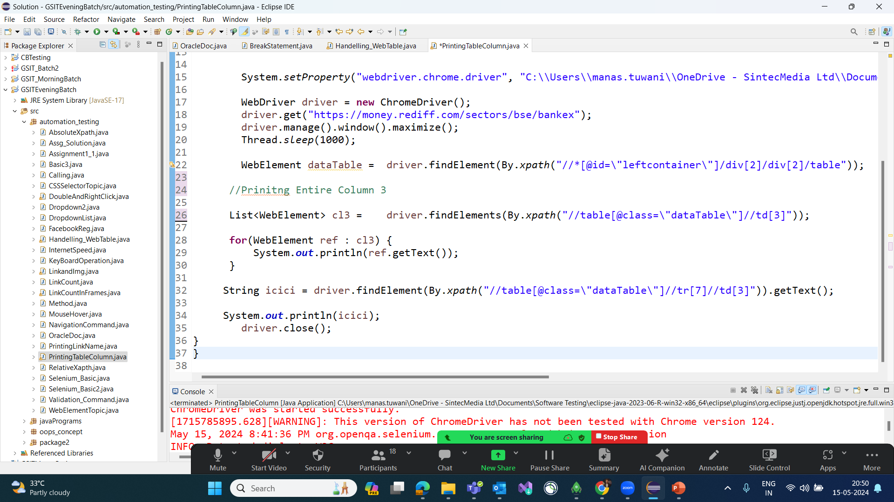

Slide 10
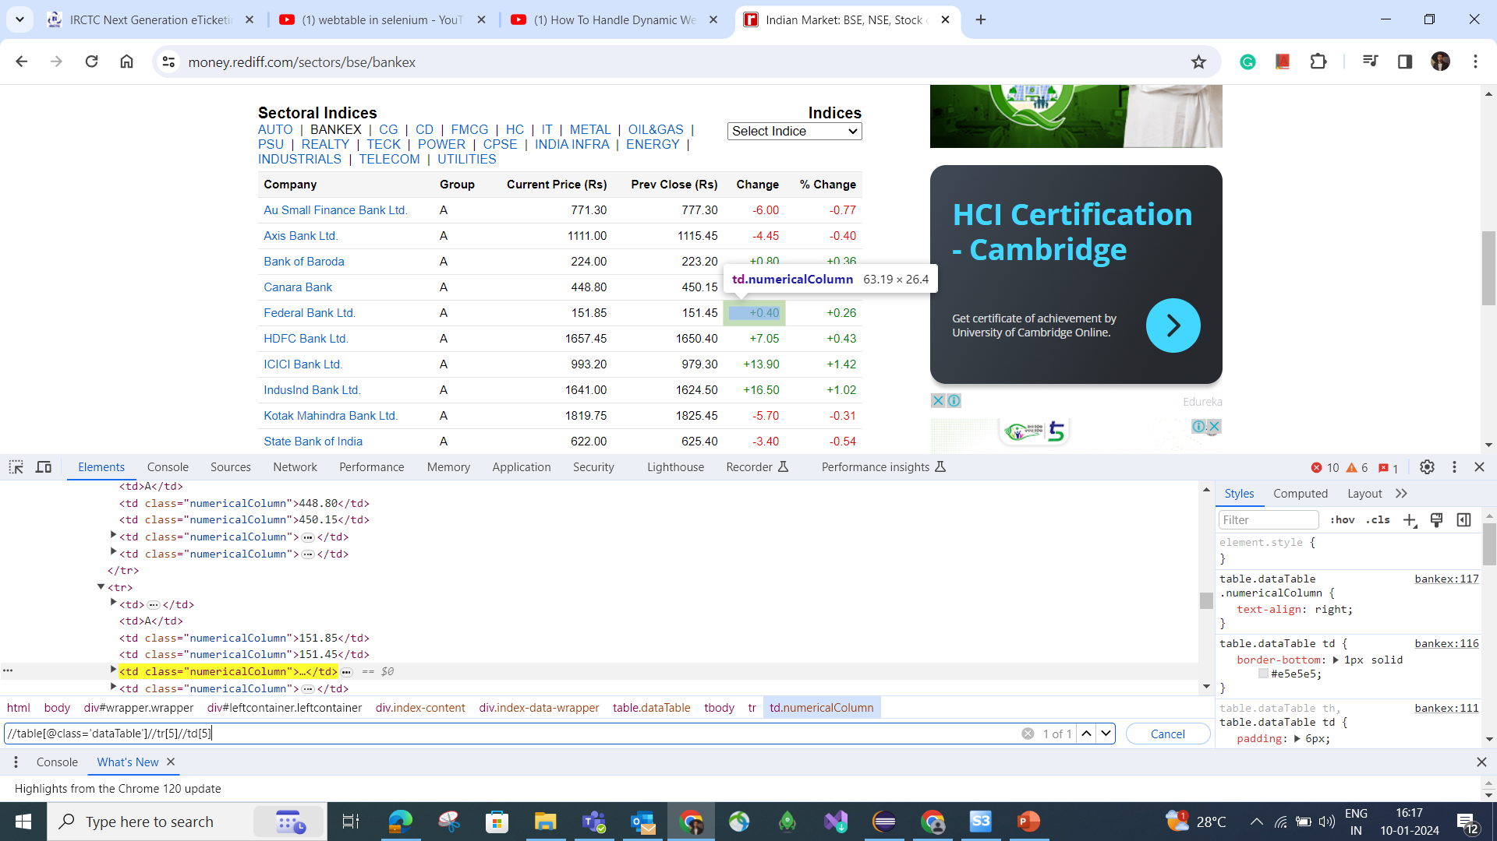
How to Handle any Dynamic value of Web table

Slide 11
FAQ’s
1. What is Web table?
2. How to read specific cell value from Web Table?
3. How to count number of rows in a table
4. How to read all rows values from first column in Table?
5. What is the tag name for row, column and Data?

Slide 12

Practice Assignment
Launch the chrome browser.
Open URL: https://web-locators-static-site-qa.vercel.app/Web%20Table
Print total Number of Columns in the table
Select “Static Table - Subject Topper” table
List/Print the names of all header columns
Print all the subject name from column 2
Close the browser window.

